Slide 1
Spasticity Management for Transverse Myelitis
R. Samuel Mayer, MD,
Associate Professor and Vice Chair for Education,
Department of Physical Medicine and Rehabilitation

Slide 2
CME Disclosure
Abobotulinum toxin A, incobotulinum toxin A, botulinum toxin B and phenol are not US Food and Drug Administration (FDA) approved for use in spasticity
Onabotulinum toxin A is only indicated for spasticity of the upper limb
I have received no direct honoraria, speakers’ fees, or other financial incentives, from industry, relevant to this talk. My department has received unrestricted educational funds from Allergan and Merz.

Slide 3
Objectives
How do you assess spasticity?
Distinguish between generalized and localized impairments
Discuss treatment options for specific upper motor neuron syndromes

Slide 4
Consequences of Spasticity
May interfere with mobility, exercise, joint range of motion
May interfere with activities of daily living
May cause pain and sleep disturbance
Can make patient care more difficult

Slide 5
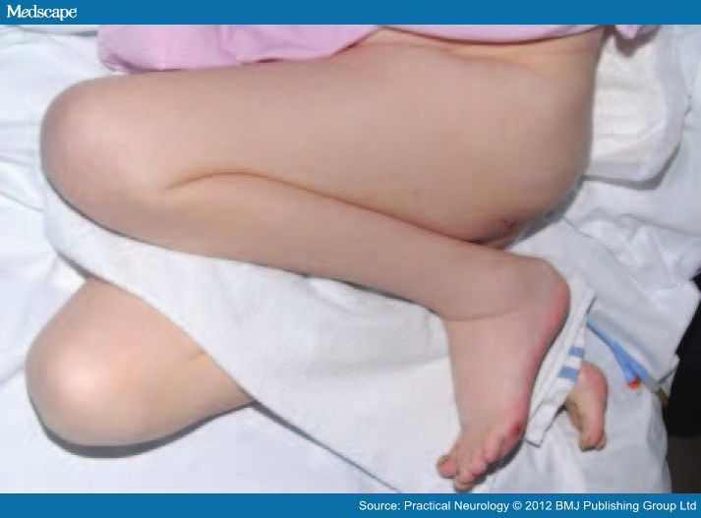

Slide 6
Possible Advantages of Spasticity
Maintains muscle tone
Helps support circulatory function
May prevent formation of deep vein thrombosis
May assist in activities of daily living
May assist in maintaining erect posture
May assist in gait

Slide 7
Mechanical vs. Spastic
Contracture
Fixed
Tendon and/or ligament
Charcot joint
Heterotopic ossification
Dynamic
Slow stretch
Palpable antagonistic muscle action
Increased reflexes
Most often, both mechanical and spastic factors

Slide 8
Key Questions in History
Location?
Time of day, aggravating/alleviating factors? (diary)
Painful spasms?
Functional limitations?
Need for extensor tone in legs for standing?

Slide 9
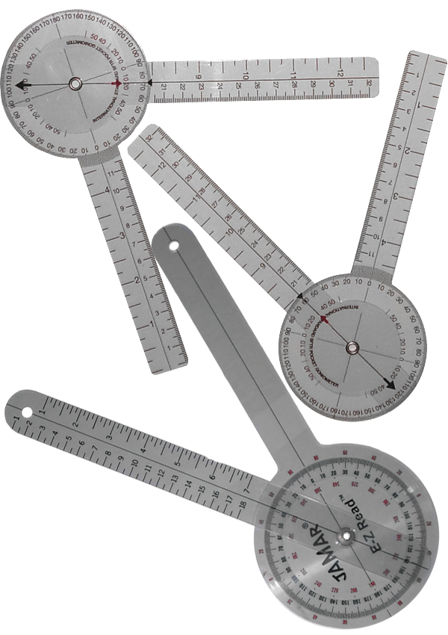
Physical Exam
Standard musculoskeletal exam including range of motion (measured with a goniometer)
Standard neurological exam
Clonus
Ashworth scale

Slide 10
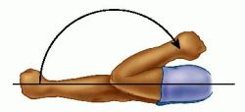
Modified Ashworth Scale (MAS)
0 = Normal tone
1 = Slight “catch”
1+ = Significant “catch”
2 = Mild, limb moves easily
3 = Moderate, passive range of movement difficult
4 = Severe, rigid limb

Slide 11
Goal Attainment Scales
Select 2 SMART (specific, measurable, achievable, realistic, time-frame) goals with patient
  -2 did not achieve by a lot
  -1 did not achieve by a little
  0 achieved
  +1 exceeded by a little
  +2 exceeded by a lot

Slide 12
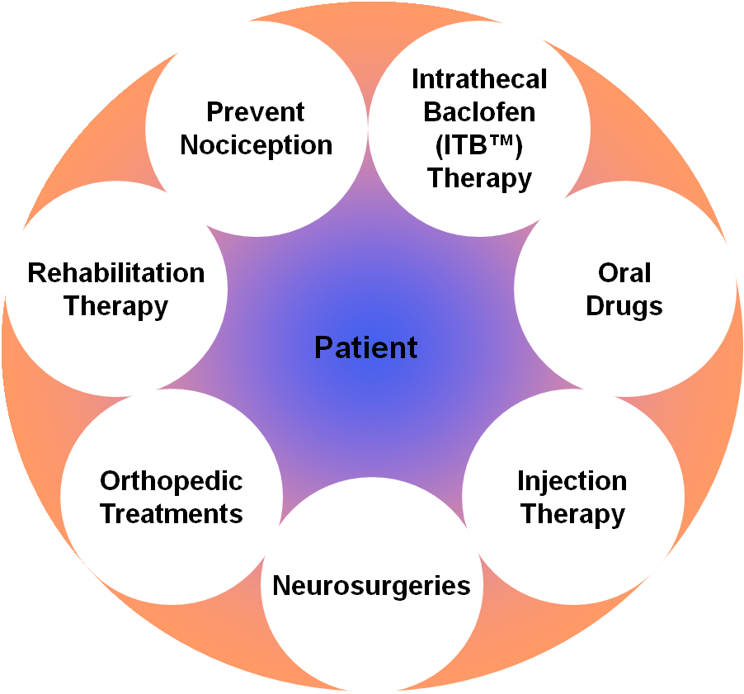
Spectrum of Care for
Management of Spasticity

Slide 13
Generalized Spasticity
(>2 limbs involved)

Slide 14
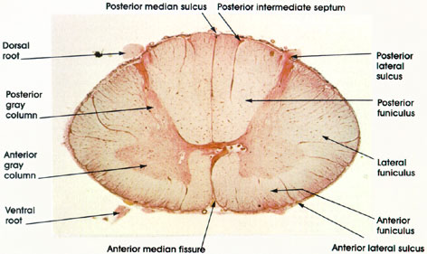
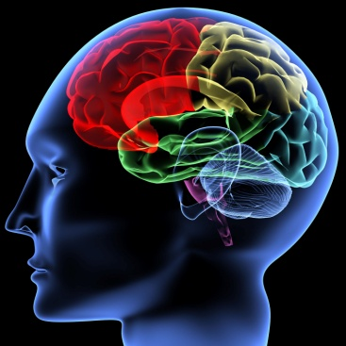
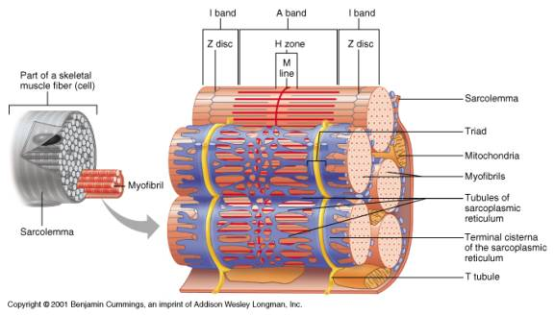
Oral Medications
Baclofen
  Works on spinal cord
Tizanidine
  Works on brain
Dantrolene
  Works on muscle

Slide 15
Intrathecal Baclofen
Generalized spasticity
Not controlled or side effects from oral meds
Delivers @ 1/50 dose baclofen direct to cerebrospinal flluid
Infinitely programmable
Refill every 3 to 12 months
Mechanical complications

Slide 16
Localized Spasticity
Onabotulinumtoxin A (Botox®), Abobotulinumtoxin A (Dysport®) , Incobutlinum toxin A (Xeomein)
Rimabotulinumtoxin B (Myobloc®)

Slide 17
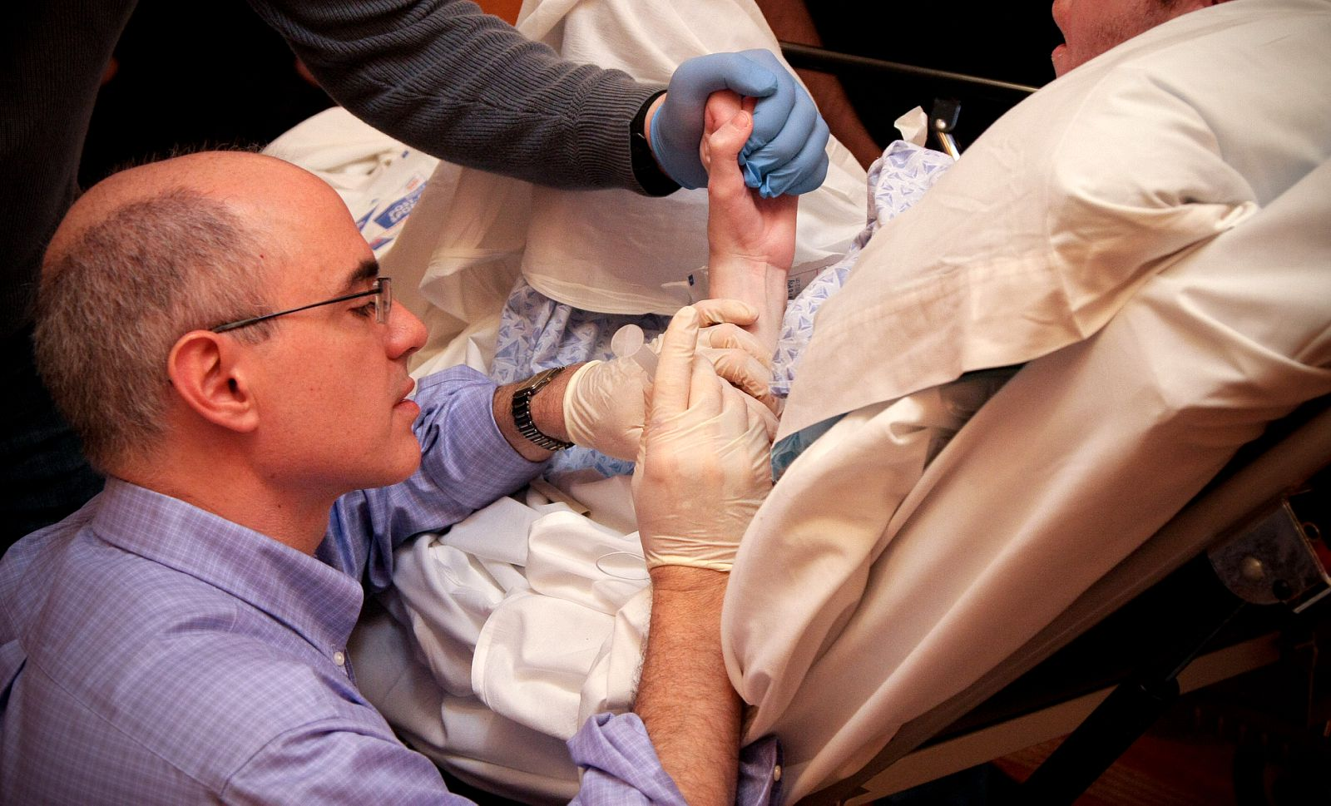

Slide 18
Phenol and Alcohol
Causes degeneration of both motor sensory fibers
Can do nerve blocks in pure motor nerves, but avoid mixed or sensory nerves
Motor point blocks
Lasts 4 to 9 months

Slide 19
Phenol and Alcohol
100% effective in gastrocnemius injections for six months.
90% patients injected with alcohol had relief at nine months, 70% of those with phenol.
Kocabas H et al. Eu J Phys Med Rehabil 2010; 46: 5-10

Slide 20
Botulinum Toxins
Can be injected using anatomic landmarks or as motor point block
4 formulations in US onabotulinum toxin A (Botox®) + abobotulinum toxin A (Dysport®), incoboutlinum toxin A (Xeomin®), and rimabotulinum toxin B (Myobloc®).
Lasts 2 to 4 months
NOT FDA approved for spasticity, except onabotulinum toxin A for upper limb only.

Slide 21
Data Limited in TM and SCI
SCI only
1 trial 28 patients
Lower limbs: 56% improved gait, 71% improved positioning.
Upper limbs: 78% improved hand function, 66% improved hygiene, 80% improved pain

