Slide 1
Bowel and Bladder Management Following Transverse Myelitis
Janet Dean, MS, RN, CRRN, CRNP
Pediatric Nurse Practitioner
International Center for Spinal Cord Injury
Department of Physical Medicine and Rehabilitation
Johns Hopkins Hospital

Slide 2
Bowel and Bladder
Functions
Store waste
Release waste at the appropriate times
Each system has
Muscular storage area
Outlet valve or sphincter
Control
Voluntary
Involuntary

Slide 3
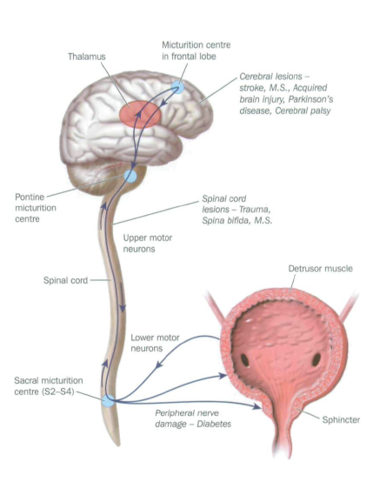
Bladder Function
Storage area
Bladder or detrusor
Outlet valve
External urinary sphincter
Bladder distends
Nerves send signals to cord
Signals travel up to brain
Brain decides what to do
Sends signals down cord
Store or release
Notes:
detrusor sphincter dyssynergia

Slide 4
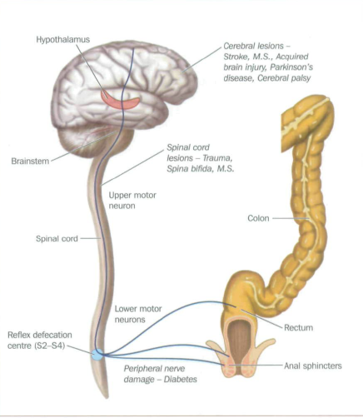
Bowel Function
Storage area
Rectum
Outlet valve
External anal sphincter
Rectal distension
Triggers urge to defecate
Triggers holding reflex
Nerves send signals to Cord
Signals travel to the brain
Brain decides what to do
Sends signals down the cord
Hold or release

Slide 5
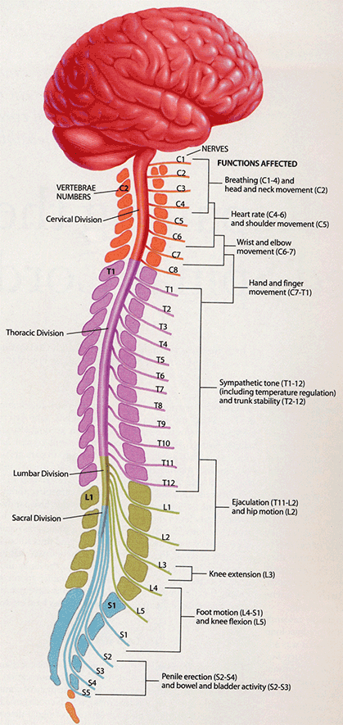
Neurogenic Bowel and Bladder
Transverse Myelitis
Changes in your bladder and bowel functioning
Disrupts sensation of having to urinate or have a bowel movement
Disrupt the coordination between the brain and the bowel or bladder
Voluntary control of sphincters is lost
Changes how you go to the bathroom

Slide 6
Neurogenic Bowel and Bladder
Higher level of Injury (T12 and above )
Spastic or reflexic neurogenic
Lower Level of injury (T12 and below)
Flaccid or areflexic neurogenic
Bladder
Bladder is spastic and irritable
Urinary sphincter is tight and does not relax voluntarily
Difficulty storing and releasing urine
Bowel
Decreased GI motility
Rectum holds stool
Anal sphincter tight and does not relax voluntarily
Difficulty releasing stool
Bladder
Bladder will not contract when it becomes full
Urinary sphincter is loose and fails to contract
Difficulty storing urine
Bowel
Rectum holds stool
Anal sphincter fails to contract
Difficulty holding stool

Slide 7
Spastic – Reflexic
Spastic Bladder
Spastic Bowel
Problems
Bladder tries to distend
Bladder spasms
Urgency
Frequency
Incontinence
Bladder sphincter dyssynergia
Difficulty initiating and maintaining a stream of urine
Vesicoureteral reflux
Kidney damage
Problems
Rectal distension
Anal sphincter tightens
Unable to release stool
Constipation
Impaction
Notes:
Bladder spasms –
Urgency and frequency
Problems over the long run
Thick and inelastic bladder
Medications to relax the bladder very important
decrease back-up to kidneys
hold more urine decrease incontinence
Harder to urinate
Medications to relax the sphincter
Urgency and frequency
May get to the toilet but have difficulty releasing stool
Valsalva or contraction of the abdominal muscles pushing against an closed sphincter

Slide 8
Flaccid-Areflexic
Flaccid Bladder
Flaccid Bowel
Problems
Bladder very relaxed
Does not contract - overfills
Sphincter outlet fails
Incontinence
Urine leaks out
Cough
Sneeze or
Activities that contract abdominal muscles
Problems
Rectum dilates
Outlet sphincter fails
Incontinence
Stool leaks out
Cough
Sneeze
Activities that contract abdominal muscles

Slide 9
How do I know Which Type I have?
Bladder
Bowel
Urology evaluation
Urodynamic or Cystometric studies.
VCUG – voiding cystourethrogram
Renal Ultrasound
Rectal exam
Sensation
Voluntary contraction
Other GI exams are usually not necessary
Without Formal Evaluation
Level of Injury
Lower extremity muscle tone

Slide 10
How to Manage Bowel and Bladder
Healthy Habits
Healthy diet
Drink, Drink, Drink spread fluids out over the day
Fiber – help with stool constituency
Activity
Good hygiene
Do it yourself
Assistive devices
Positing equipment
Direct own care
Establish a good routine

Slide 11
Bowel and Bladder Programs
Goals
Prevent incontinence and accidents
Empty bowel and bladder at predictable times
Maintain health and prevent complications
Impaction
Constipation
Diarrhea
Thick inelastic bladder
Frequent urinary tract infections
Kidney damage

Slide 12
Bladder Management
Spastic
Flaccid
Frequent and urgent urination
Medications to relax the bladder
Oxybutinin
Intermittent Catheterization
Every 4 hours (5x/day)
Leaking of urine
Medications not effective
Intermittent catheterization
Every 3-4 hours
Prior to doing activities that cause valsalva

Slide 13
Other Options for Bladder Management
Men - Condom catheter
overflow
Indwelling Foley catheter
Not recommended
Suprapubic tube
Reversible minor surgery
Increased UTI and bladder bancer
Catheterizable stoma placed in belly button
Permanent, major surgery
less UTI and less bladder Cancer

Slide 14
Bowel Management
Spastic
Flaccid
Urgency and frequency
May get to the toilet but have difficulty releasing stool
Valsalva or contraction of the abdominal muscles pushing against an closed sphincter
Rectal sphincter will not hold stool
Frequent leaking of small amounts of stool
Activities that cause valsalva will cause leaking of stool

Slide 15
Bowel Management
Bowel Program
Takes planning and routine
Best done every day to every other day
Adults in AM Kids in PM
Should take 15 minutes to 1 hour
Same time (after meal or snack is ideal)
Generally a combination
Medications
Manual disimpaction
Digital stimulation
Work with you health professionals
Guidelines and advice
Customize what works for you

Slide 16
Bowel Management
Manage stool consistency
Diet
Fiber (or supplement)
Fluid
Medications to soften stool
Docusate Sodium
PEG (lower doses)
Promote GI motility
Senna
PEG (higher doses)

Slide 17
Bowel Management
Positioning
Sit up on the toilet or bedside commode
Lay on left side if you can not sit up
Children
Be sure feet are supported on a foot stool and they are comfortable

Slide 18
Bowel Management
Manual disimpaction
Using a gloved, well lubricated finger inserted into the rectum to break up and gently remove stool
Remove stool that will be in the way
Digital stimulation
Inserting a gloved, well lubricated finger into the anal sphincter and gently rotating the finger around the anal sphincter in a circular direction
Trigger reflex evacuation
Rectal Medication
Bisacodyl suppository, Magic Bullet suppository. Enemeez mini enema
Trigger reflex evacuation

Slide 19
Bowel Program
Spastic
Flaccid
Routine Bowel Program
Every 1-3 days
Soft formed stool
Trigger reflex evacuation
Digital stimulation
Suppository
Routine Bowel Program
1-2 x/day
Firm formed stool
Easy to remove but does not leak
Suppositories generally do not work
Manual disimpaction
1-2 times per day
prior to activities that cause valsalva

Slide 20
Bowel Program
Spastic Bowel
Flaccid Bowel
Manually remove stool from rectum
Insert suppository
Digital Stimulation after 5-15 minutes
Continue digital stimulation every 5-10 minutes 3-4 times
Manually remove stool from rectum.
Can try digital stimulation
Valsalva or bearing down push ups, abdominal massage
Use caution can cause hemorrhoids

Slide 21
How do I Know Program is Complete?
Spastic
Flaccid
No stool in rectal vault after 2 digital stimulations 10” apart
Mucus and no stool
Rectal sphincter becomes tight
Rectal vault is empty

Slide 22
Other Options for Bowel Management
Flaccid Bowel
Cecostomy - reversible
ACE procedure - permanent
Allows you to do an enema from above
Spastic Bowel
Be cautions of above procedure with spastic rectal sphincter

Slide 23
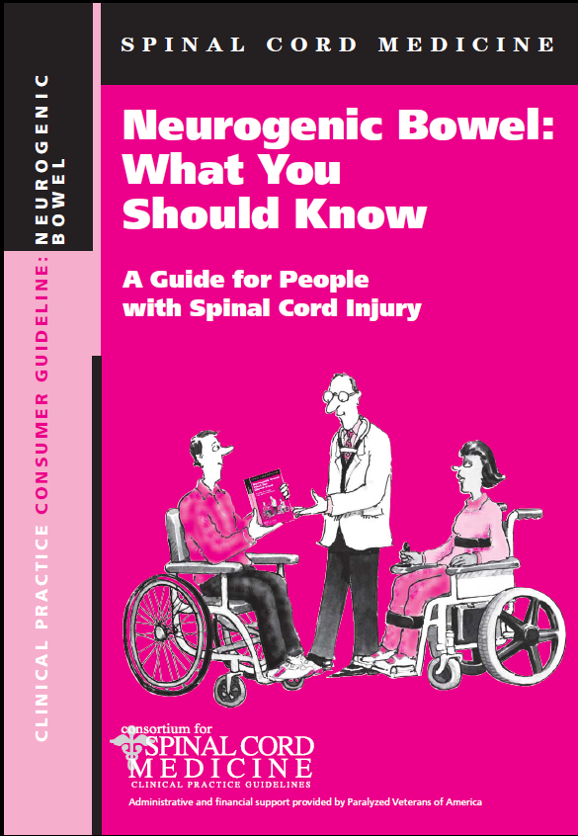
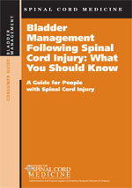
Resources
http://www.pva.org/site/PageServer?pagename=pubs_main

